Slide 1








Slide 2
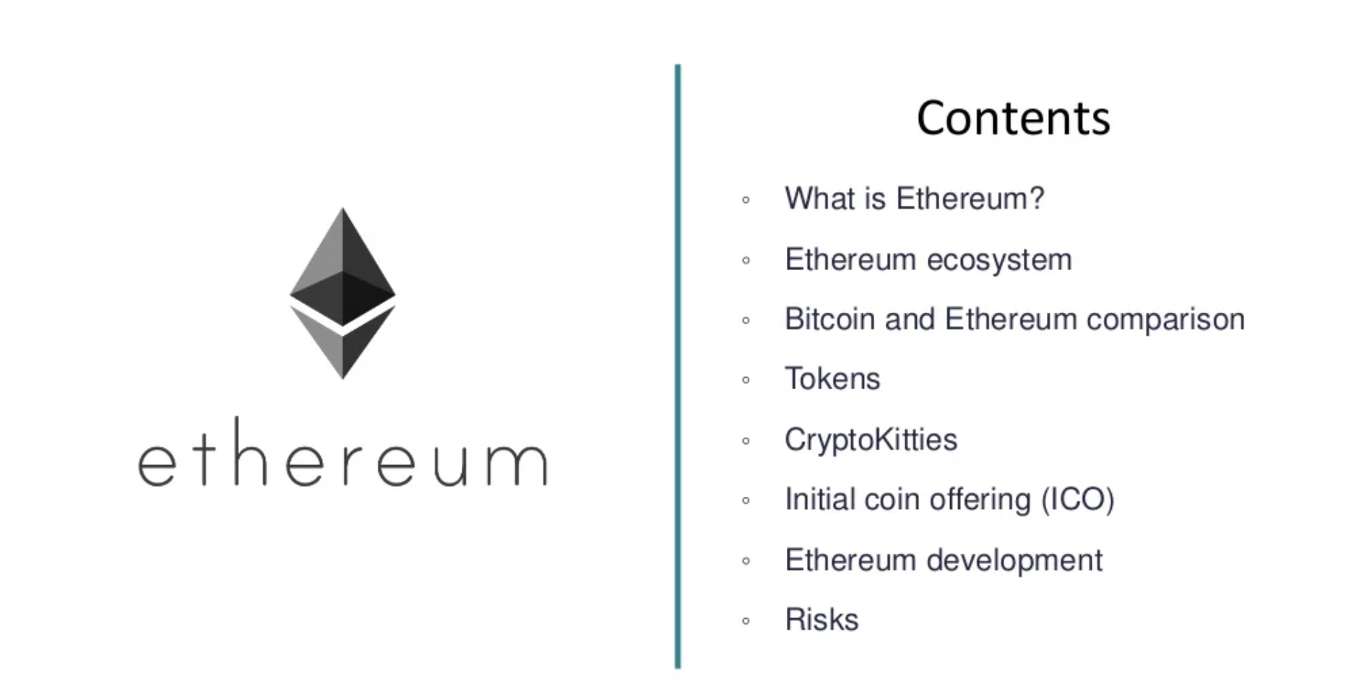

Slide 3
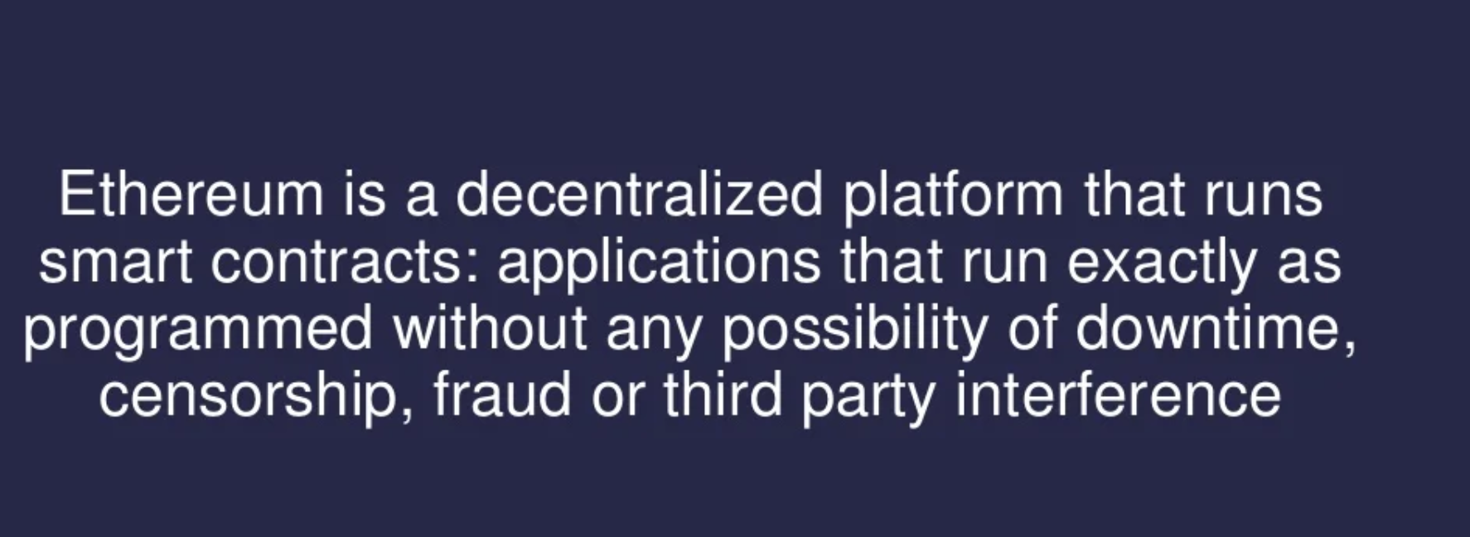
What is Ethereum

Slide 4
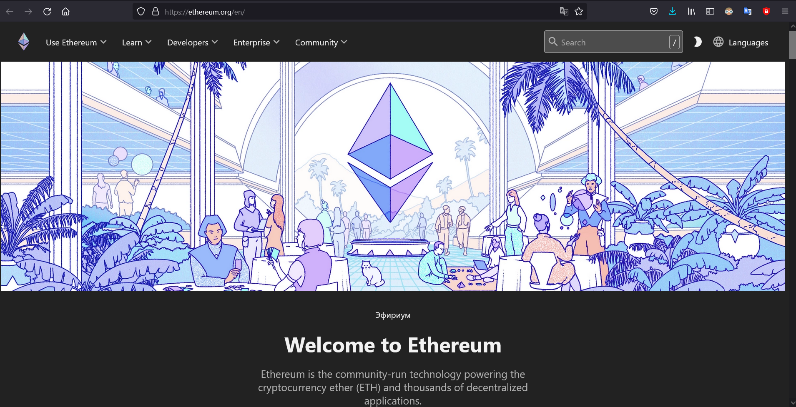
What is Ethereum: https://ethereum.org/en/

Slide 5
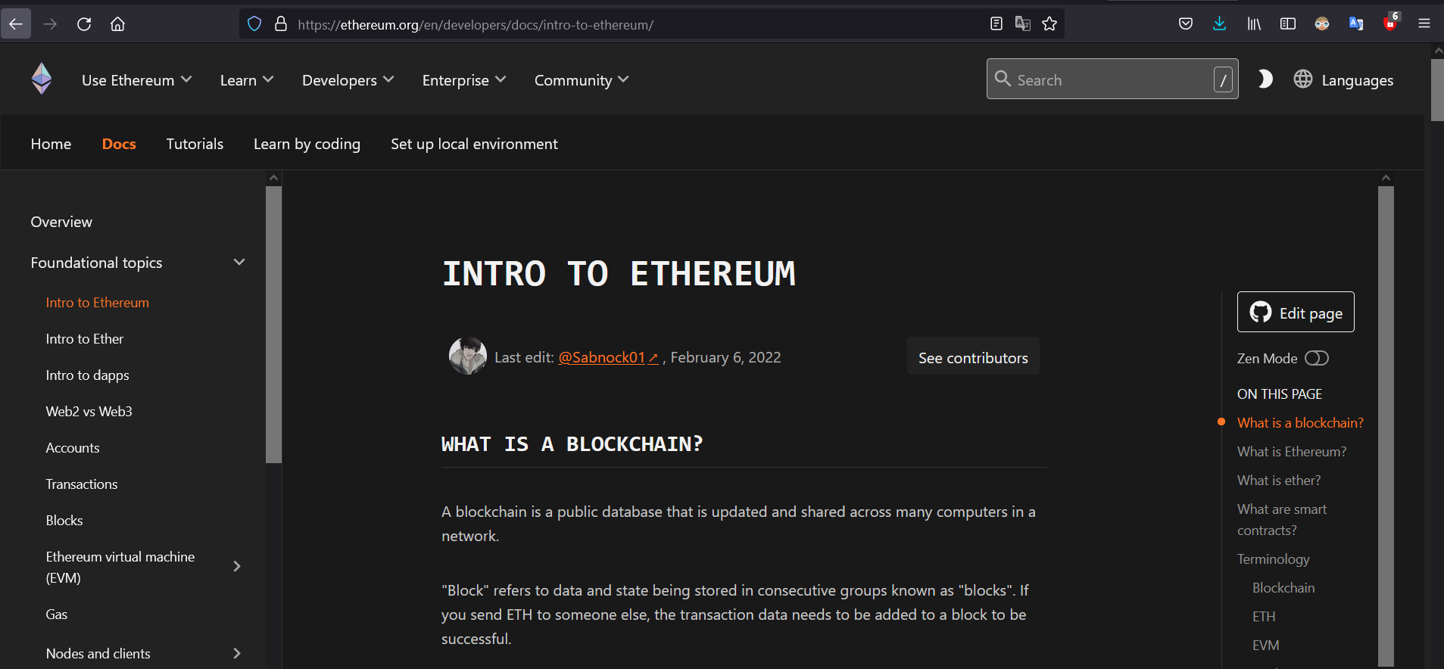
What is Ethereuem: https://ethereum.org/en/developers/docs/intro-to-ethereum/

Slide 6
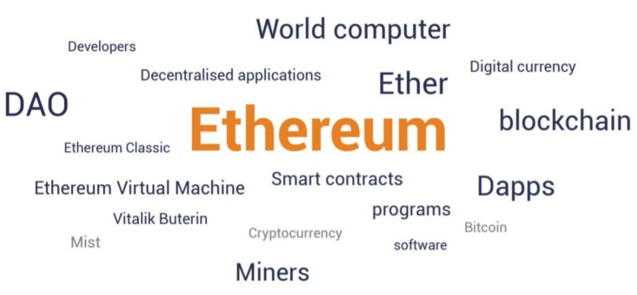
Terminology

Slide 7
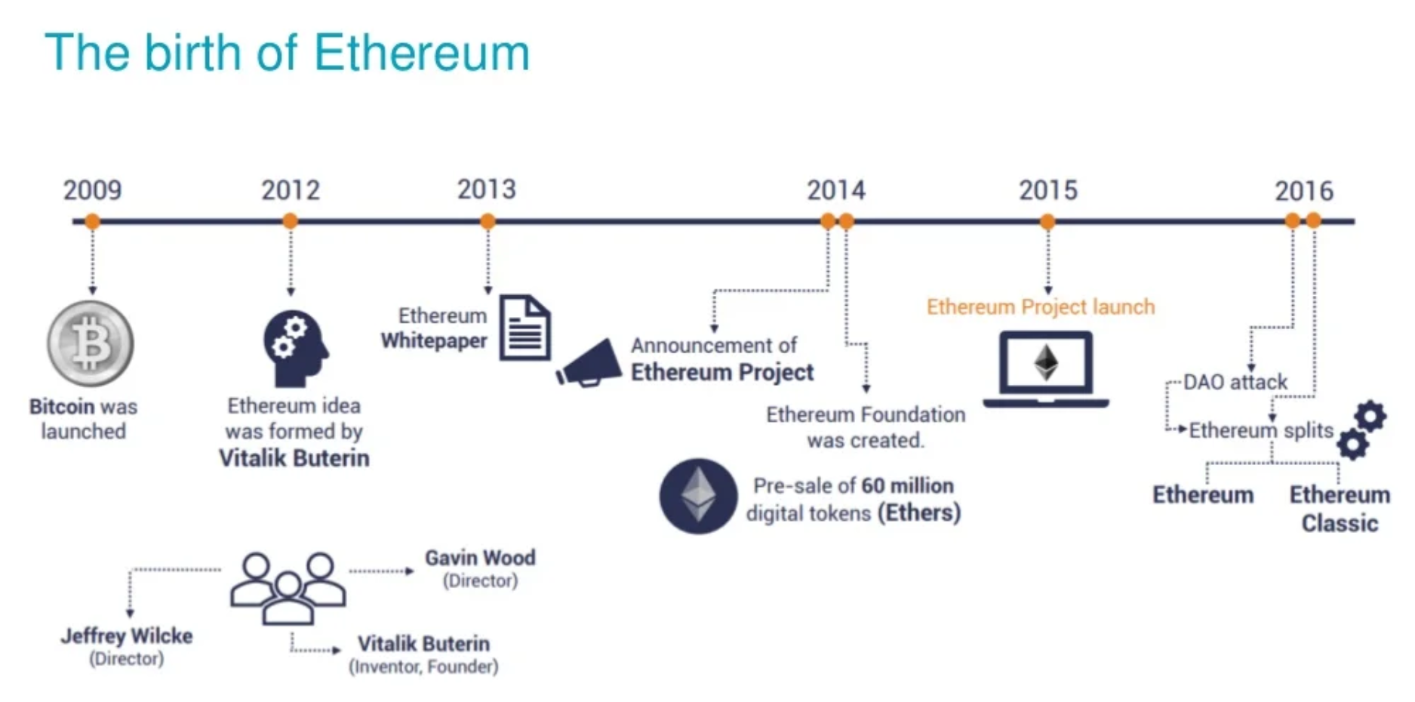
How it started

Slide 8
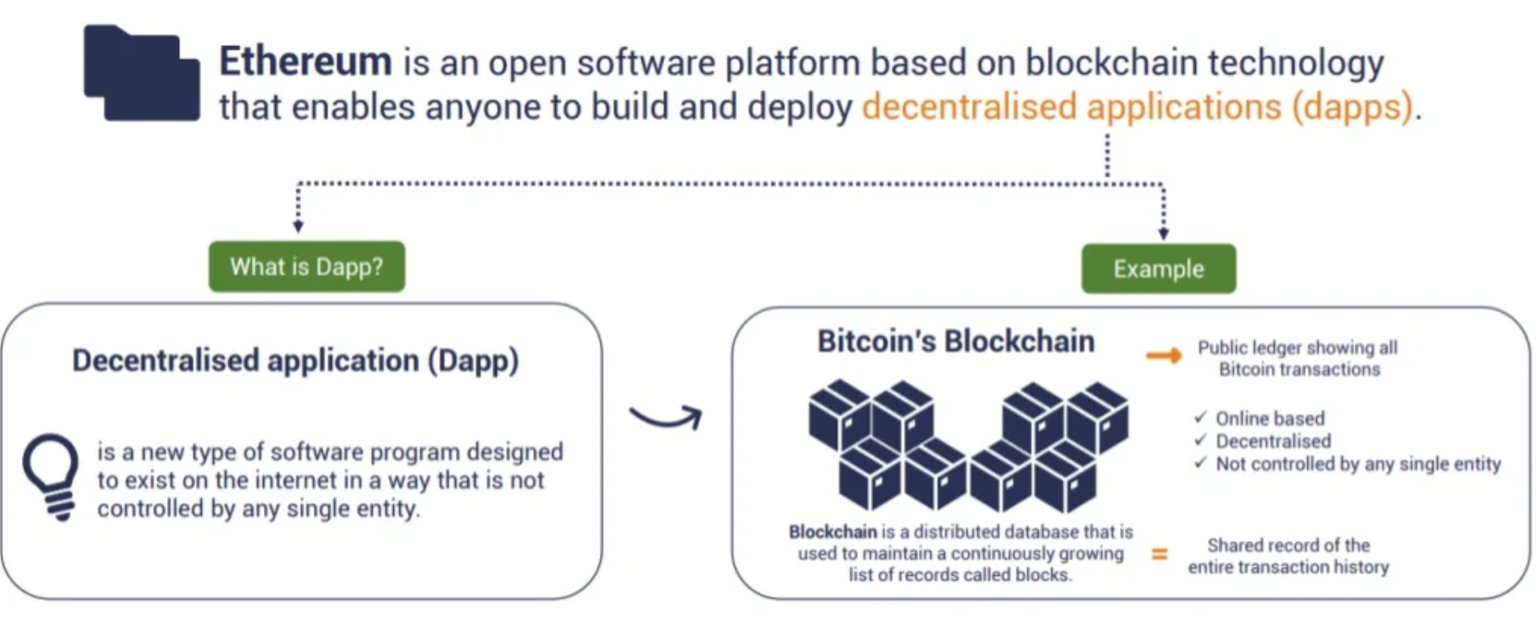
What is Ethereum

Slide 9
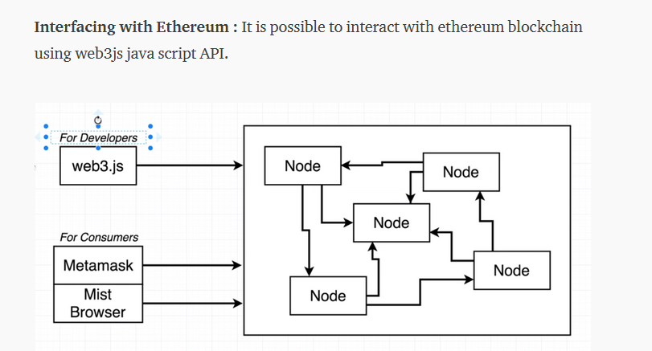
Interface

Slide 10
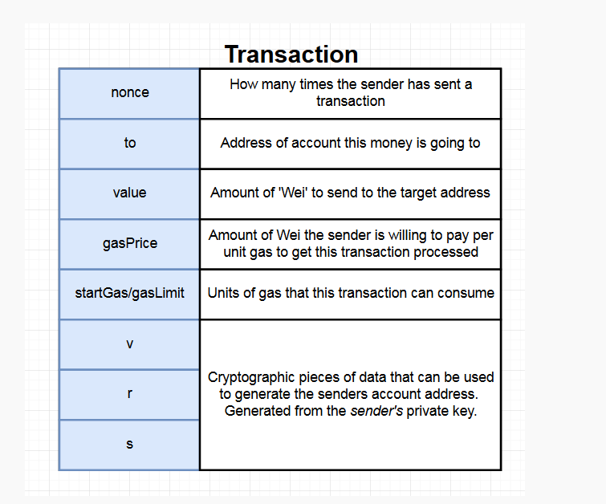

Slide 11
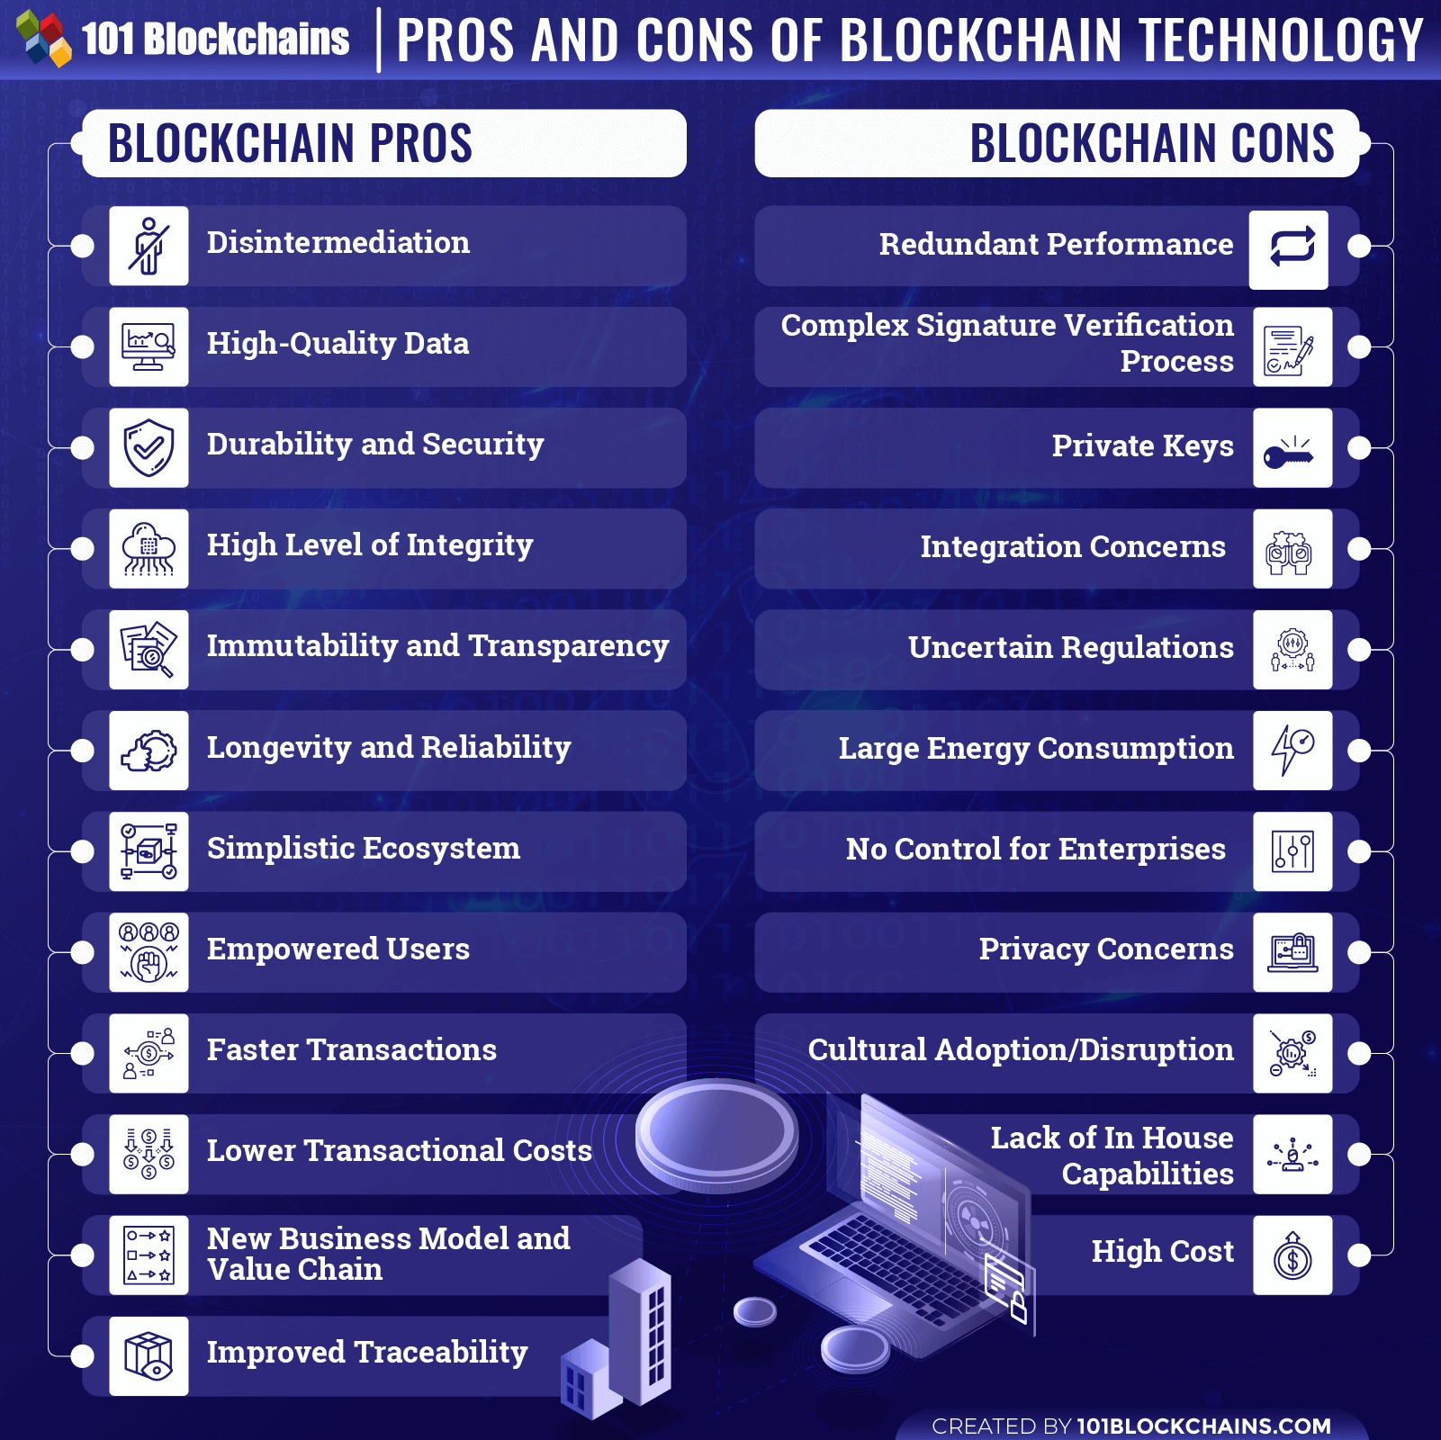
BC Pro and Cons

Slide 12
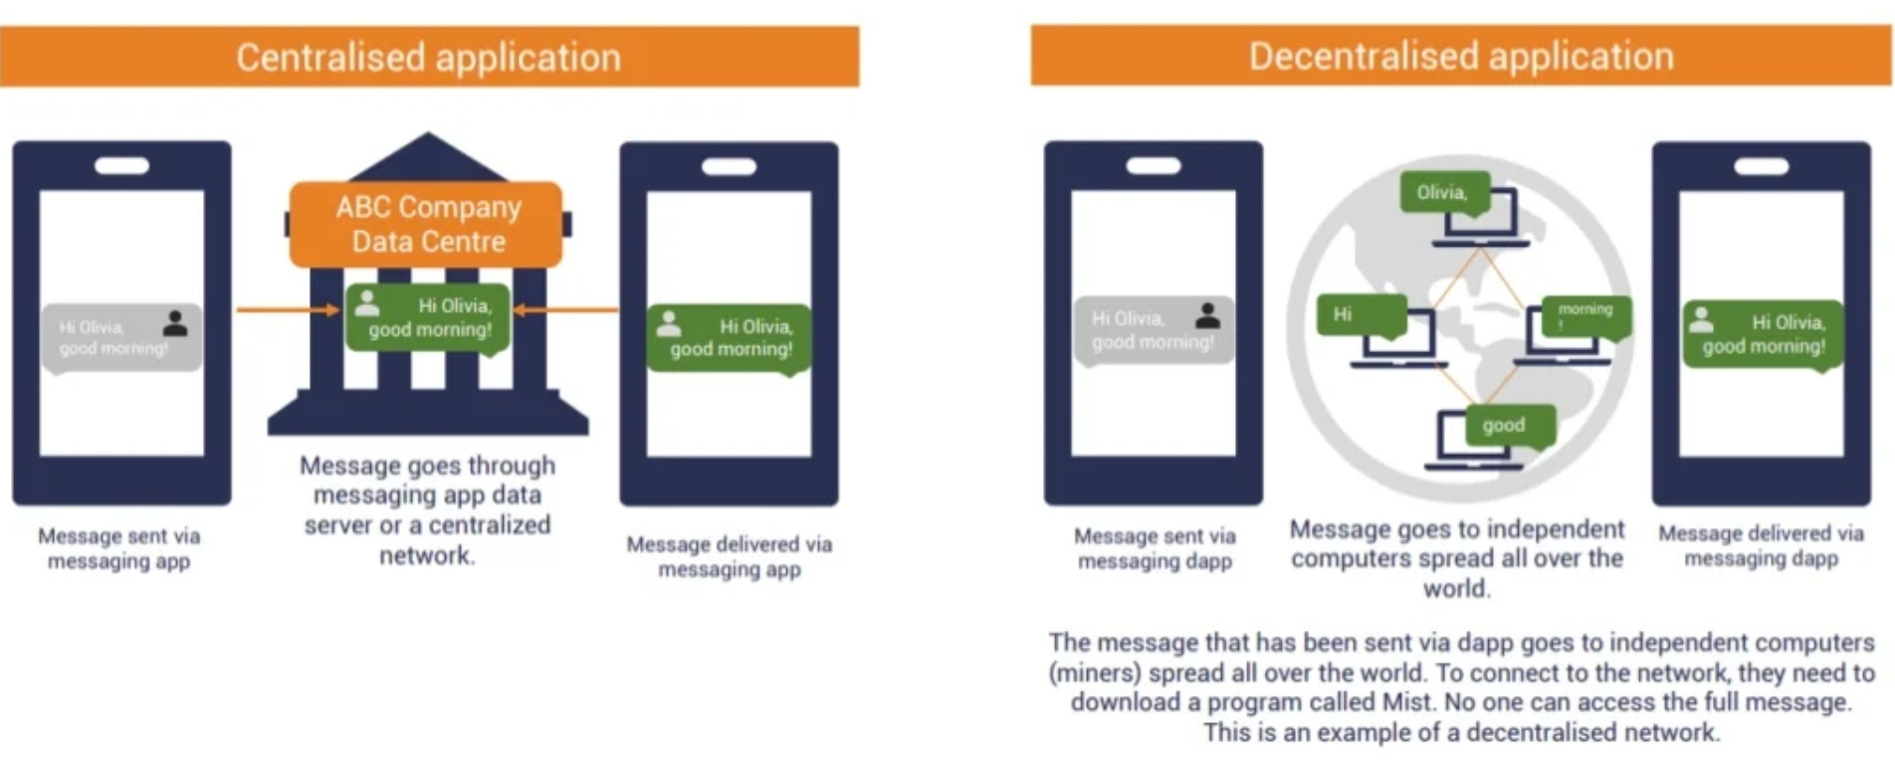
Centralised vs Decentralised

